Slide 1

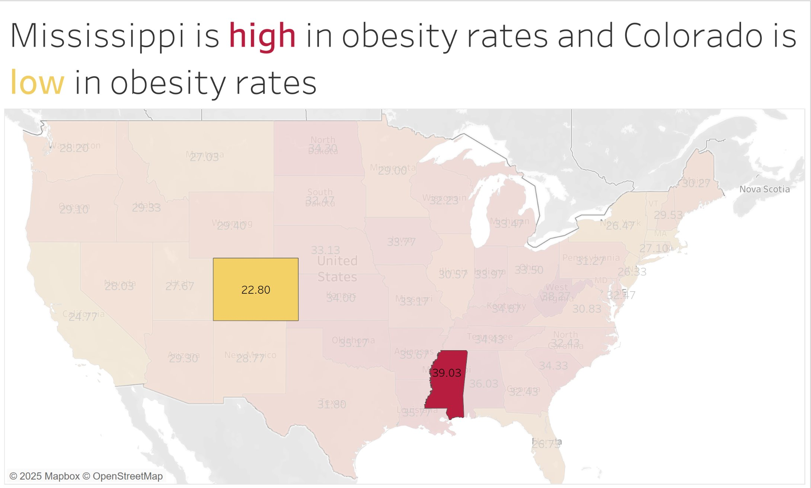
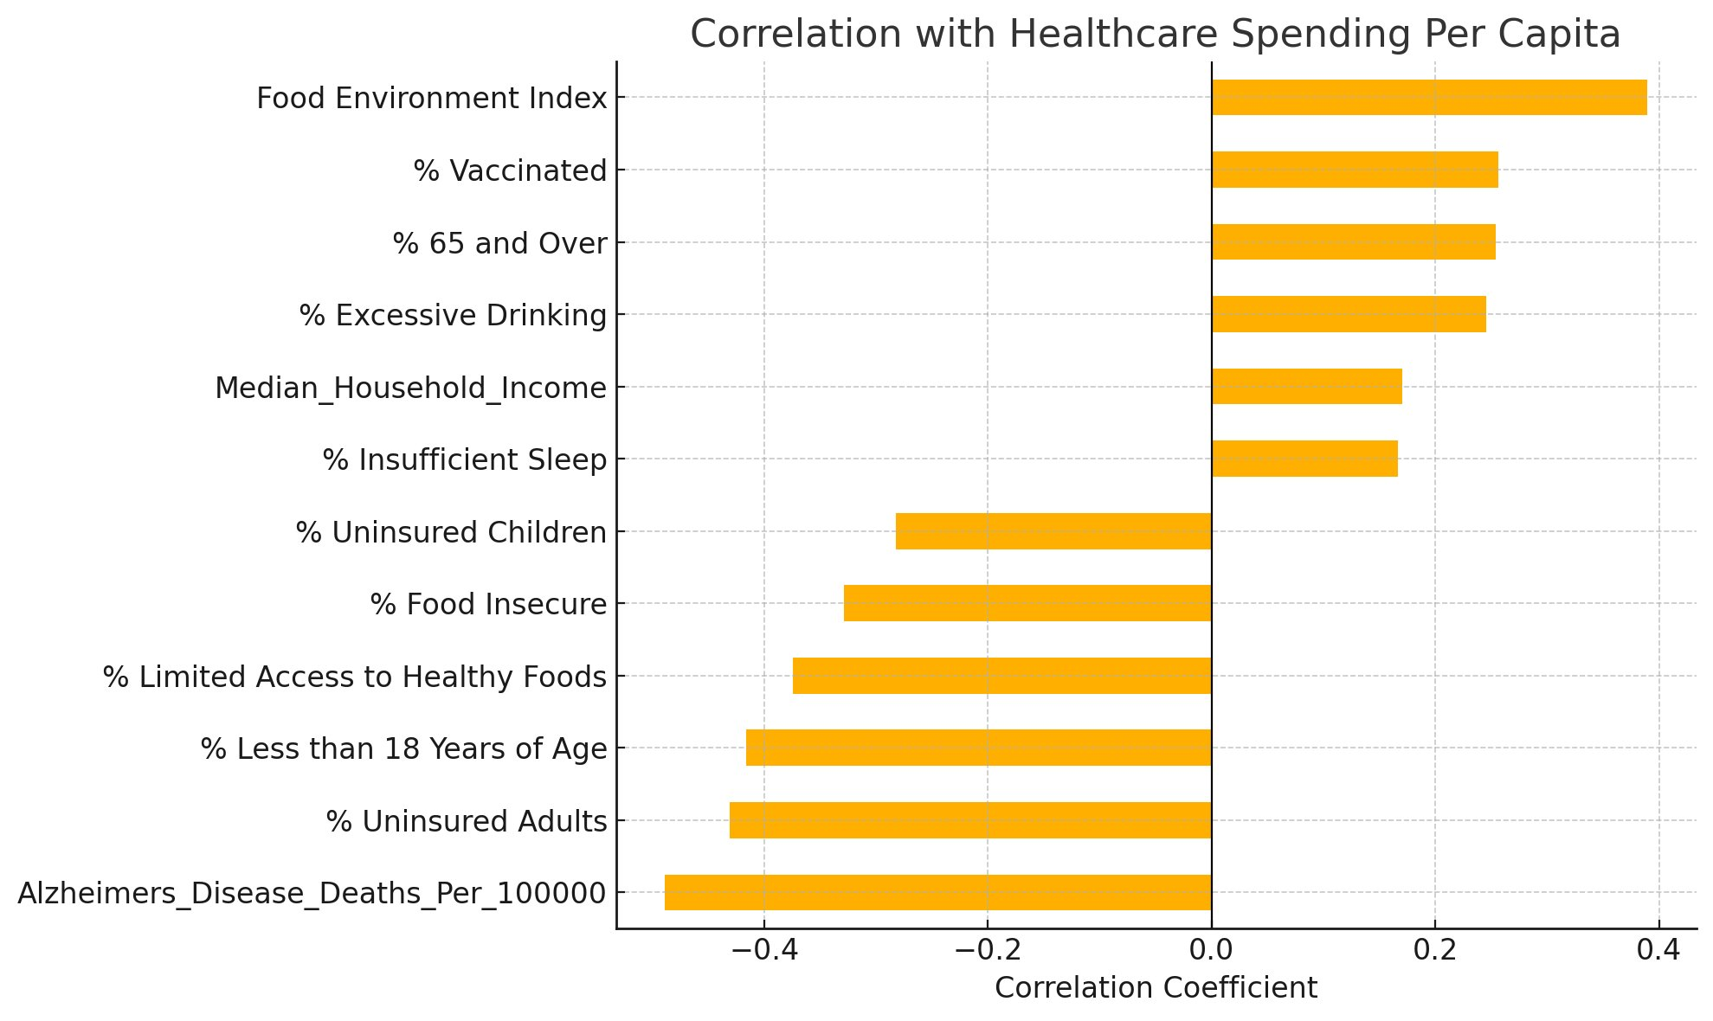
Health Status Predictors of Cost and Deaths
AArete Group 2
Charlie Doubet, Eddie Martin, Nathan Bers, Robert Mullan, Seth Barker
Abstract
Methodology
Results
Recommendations
Our project aims to identify key health indicators that most significantly impact healthcare spending and mortality rates across U.S. states. By analyzing publicly available data, we explore whether higher healthcare spending correlates with better health outcomes or more severe health challenges. Through statistical modeling and critical analysis, we determine which health factors are strongest in predicting costs and death rates, providing insights that can help guide smarter investment and policy decisions in healthcare.
Master Dataset:
We combined data from the following sources:
KFF Health Data
CDC (NCHS)
Healthdata.gov
Data.gov
County Health Rankings
Exploratory Data Analysis:
Tableau and Excel were used to make visualizations for the purpose of understanding our data better.
Decision Trees:
We wanted to find out which health factors had the biggest impact on healthcare spending and death rate.
We split up our models by region as well as by healthcare spending and death rate.
The Southeast had significantly different results compared to the rest of the country.
Paraphrased results:
Most impactful drivers of healthcare spending for the entire country:
Heart disease
Smoking rate
Obesity rates
Most impactful drivers of healthcare spending for the Southeast:
Obesity rates
Smoking rate
Alzheimer's Disease Deaths
Most impactful drivers of death rate per 100,000 for the entire country
Obesity rate
Healthcare spending per capita
Smoking rate
Most impactful drivers of death rate per 100,000 for the Southeast:
Healthcare spending per capita
Household income
Target preventable chronic conditions by investing in programs like free diabetes screenings, heart health awareness campaigns, and subsidized smoking cessation services.
Reduce smoking prevalence through public policies similar to Minnesota’s Freedom to Breathe Act, which bans indoor workplace smoking and has helped lower cancer and heart disease death rates.
Promote healthier eating habits by supporting initiatives like the Healthy, Hunger-Free Kids Act, which improves the nutritional quality of school meals to reduce childhood obesity.
Introduction
Conclusion
The U.S. healthcare system faces rising costs and varying health outcomes across different states. Understanding the underlying health factors that contribute to these trends is critical for improving care and managing expenses. This project focuses on identifying specific health indicators that influence both healthcare spending and mortality rates. By analyzing large-scale public datasets, we aim to highlight patterns and provide insights that can inform better decision-making in the healthcare industry.
Spending helps—but only when it addresses the *right* issues.
Higher healthcare spending does not always equate a healthier state
Lots of important data is private and we couldn’t access it so there is always more work that can be done

